Slide 1
AI-Powered Resume Analysis and Job Matching System
CAPSTONE PROJECT
Presented By:
Student Name- HEET JAIN
College Name- VIDYAVARDHINI’S COLLEGE OF ENGINEERING AND TECHNOLOGY
Department- AI & DS

Slide 2
OUTLINE
Problem Statement (Should not include solution)
Proposed System/Solution
System Development Approach (Technology Used)
Algorithm & Deployment
Result
Conclusion
Future Scope
References

Slide 3
Problem Statement
.
In today’s competitive job market, candidates often apply to multiple job roles without understanding how well their resumes align with specific job descriptions.
Many applicants lack the ability to:
Evaluate resume relevance for a particular job role
Identify missing skills required by employers
Optimize resumes according to industry standards
Understand strengths and weaknesses in their profiles
Manual resume evaluation is time-consuming, subjective, and may not accurately reflect the match between a candidate’s qualifications and job requirements.
Therefore, there is a need for an automated system that can analyze resumes and compare them with job descriptions to provide meaningful insights regarding candidate suitability.

Slide 4
Proposed Solution
The proposed system is an AI-based Resume Analyzer that analyzes a candidate’s resume and compares it with a given job description using Generative Artificial Intelligence.
The system performs the following tasks:
Extracts textual content from uploaded PDF resumes
Accepts job title and job description as input
Uses AI to compare resume content with job requirements
Calculates resume-job match score
Identifies strengths present in the resume
Detects missing skills or qualifications
Provides suggestions for resume improvement
Additionally, the system includes a chatbot interface that allows users to ask questions related to resume analysis results for better understanding and refinement.

Slide 5
System Approach
Frontend:
Streamlit Framework
Used to create an interactive web-based user interface for resume upload, job description input, and result visualization.
Backend:
Python Programming Language
Used for implementing logic, processing user inputs, and integrating AI services.
Libraries Used:
PyPDF2 – For extracting textual data from PDF resumes
google-generativeai – For accessing Gemini AI model
Pillow – For image handling in UI
Artificial Intelligence:
Gemini-2.5-Flash Generative AI Model
Used for resume-job comparison, skill matching, and recommendation generation.
Development Environment:
Visual Studio Code IDE , Google AI Studio API for authentication

Slide 6
Algorithm & Deployment
Step-by-Step Working:
User uploads resume in PDF format
System extracts text from resume using PyPDF2
User enters job title and job description
Resume text and job description are sent to Gemini AI model
AI model analyzes similarity between:
Candidate skills
Experience
Job requirements
AI generates:
Match Score (0–100%)
Resume Strengths
Missing Skills
Improvement Suggestions
Results are displayed on the web interface
User can ask additional questions using chat interface
System provides AI-generated responses based on analysis
.

Slide 7
DEPLOYMENT
The system is deployed locally using:
Streamlit Web Application Framework
Deployment Steps:
Install required libraries using requirements.txt
Configure Gemini API Key
Run the application using command:
streamlit run resume_analyzer.py
Application launches in local web browser
Users can upload resume and perform analysis

Slide 8
Result
The implemented system successfully:
Extracts resume text from PDF files
Analyzes compatibility with job description
Generates accurate match score
Identifies relevant strengths
Detects missing skills
Suggests resume improvements
Allows users to interact via chatbot
The system improves resume quality and helps candidates tailor their resumes according to specific job roles.

Slide 9
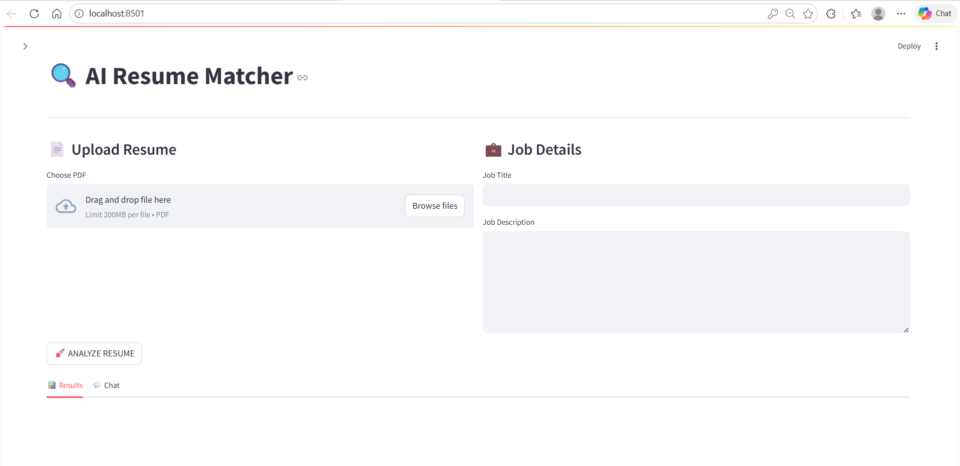
IMPLEMENTATION SCREENSHOTS

Slide 10
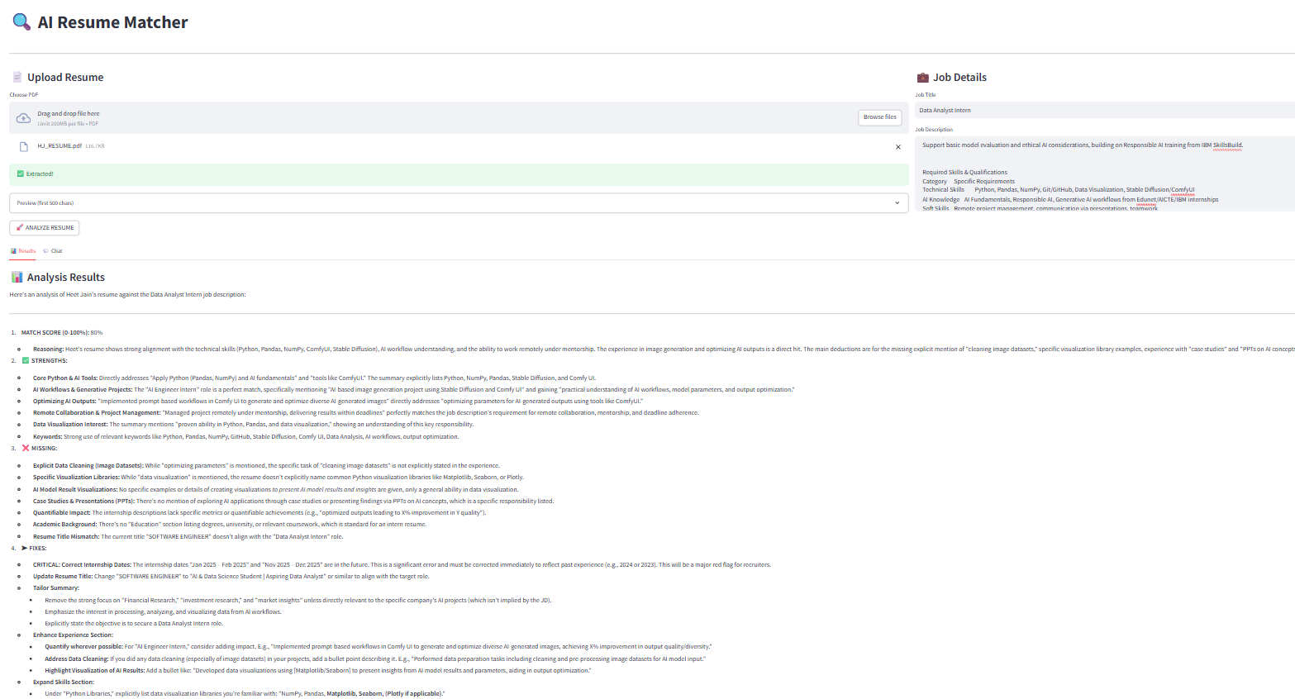

Slide 11
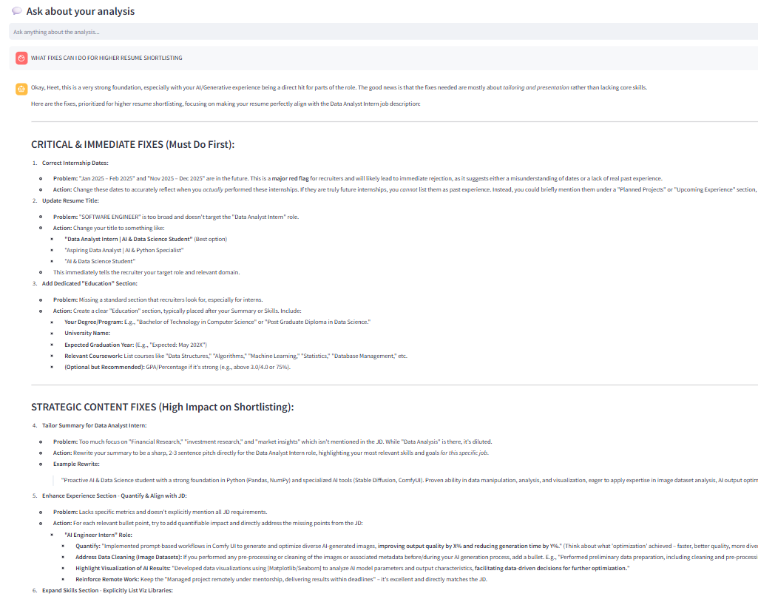

Slide 12
Conclusion
The AI Resume Matcher provides an efficient and intelligent solution for automated resume evaluation.
By leveraging Generative AI, the system:
Eliminates manual resume screening
Provides objective analysis
Enhances resume optimization
Assists candidates in improving employability
Thus, the proposed system bridges the gap between candidate qualifications and job expectations through AI-driven insights.

Slide 13
Future scope
Future enhancements may include:
Support for multiple resume formats (DOCX, TXT)
Integration with online job portals
Real-time ATS (Applicant Tracking System) compatibility check
Multi-language resume analysis
Cloud-based deployment
Role-specific resume suggestions
Automated resume formatting assistance
.

Slide 14
References
Streamlit Official Documentation https://docs.streamlit.io/
Google AI Studio Documentation https://ai.google.dev/docs
Gemini API Guide https://ai.google.dev/gemini-api/docs
PyPDF2 Library Documentation https://pypdf2.readthedocs.io/
Python Official Documentation https://docs.python.org/3/

Slide 15
Github link
Github Link :
Deployment Link:
Locally Deployed using Streamlit Framework Application URL: http://localhost:8501/
https://github.com/HeetJain-09/AI-RESUME-ANALYZER

Slide 16
THANK YOU

